Slide 1
DevOps & Cloud Overview
Presenter: Mohammed Rafiq
Date : 27-June-2021

Slide 2
Agenda
DevOps Overview
What is Software Development Process ?
Traditional approach
Problems faced by teams
Solution: DevOps Culture
Waterfall vs Agile
DevOps tools & technologies
Cloud Computing Overview
Traditional Data Centres
Deploying app on-prem vs cloud
What is Cloud computing ?
Cloud Service Models
Ground Rules

Slide 3
DevOps Overview

Slide 4
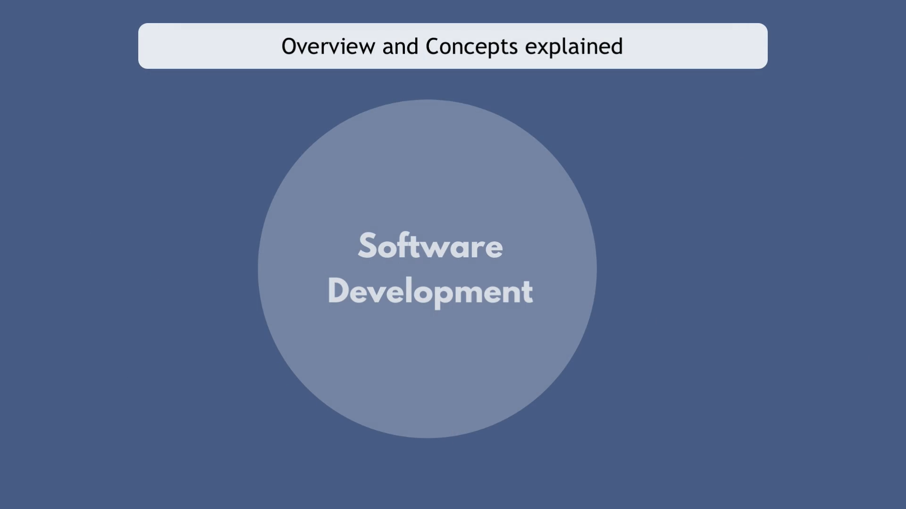
What is Software Development ?
Role
Role
Exp: Facebook, Uber, Cred, etc
Hiring resources such as Developers, Testers, DevOps engineers, Support engineer
Role
Role

Slide 5
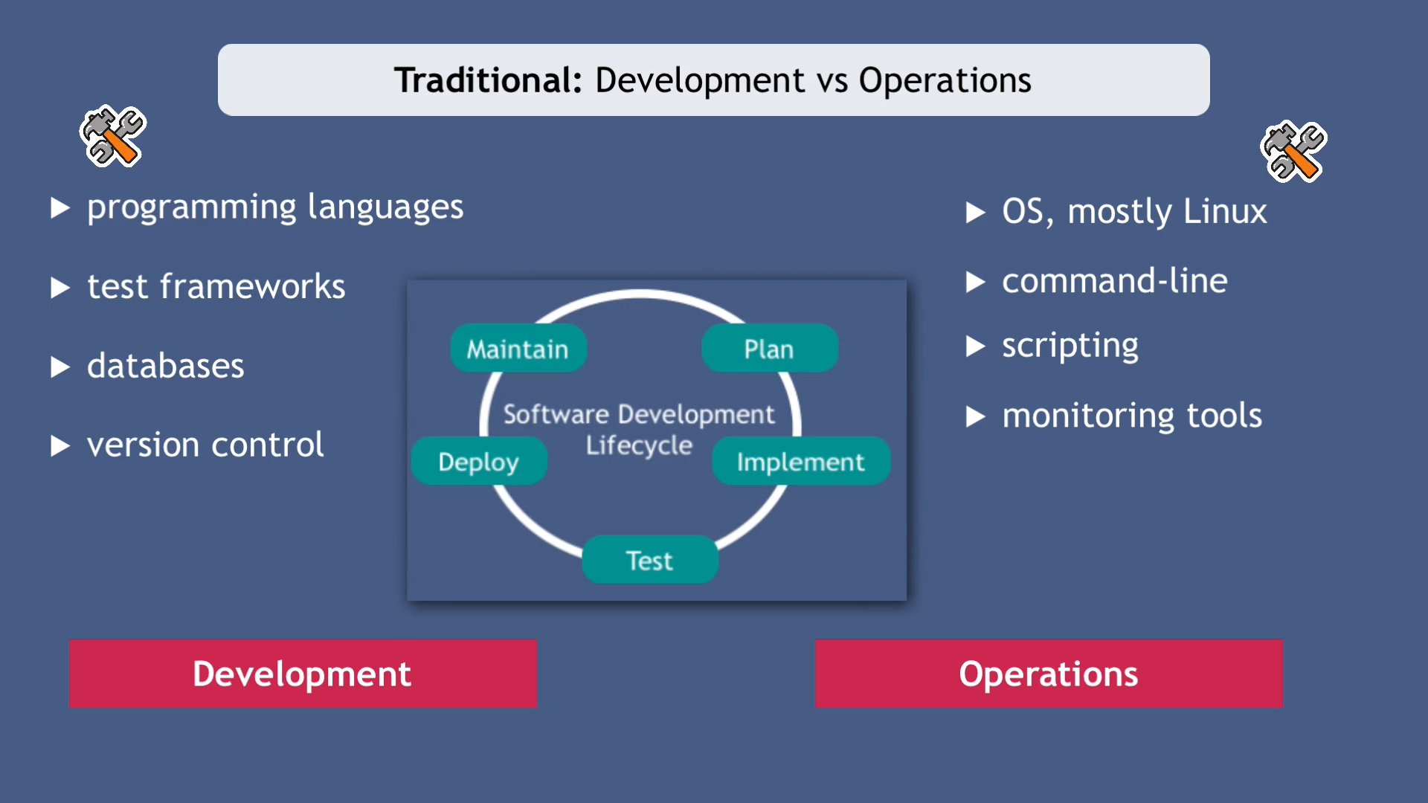
Overview & Concepts
Consultants, Developers, Testers, System Admin, Support engineers, etc
Each role has good overview of their own department.
Overall Big Picture ?
Why we do what we do ?

Slide 6
SDLC
TESTING:
Test the new features
Test old code/overall code.
Testing done by developers, dedicated testers.
Manual vs Automated testing.
DEVELOPMENT:
Software developed using different programming languages.
Different teams per feature/functionalities.
Fix bugs in the code.
OPERATIONS:
Run software on productions
Maintaining the application
RELEASE:
Build Application
Run the application on servers.
Upgrade software.

Slide 7
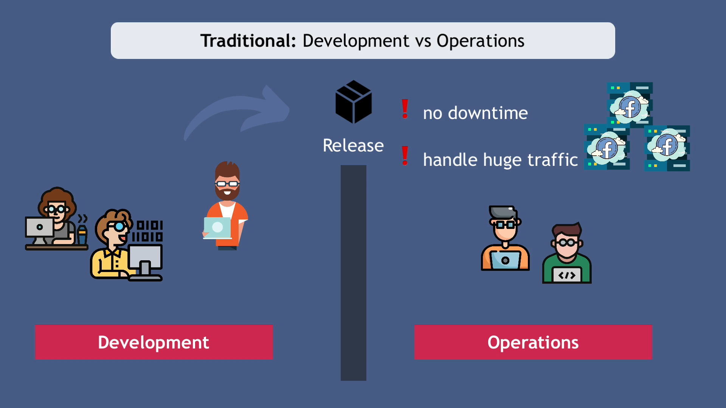

Slide 8
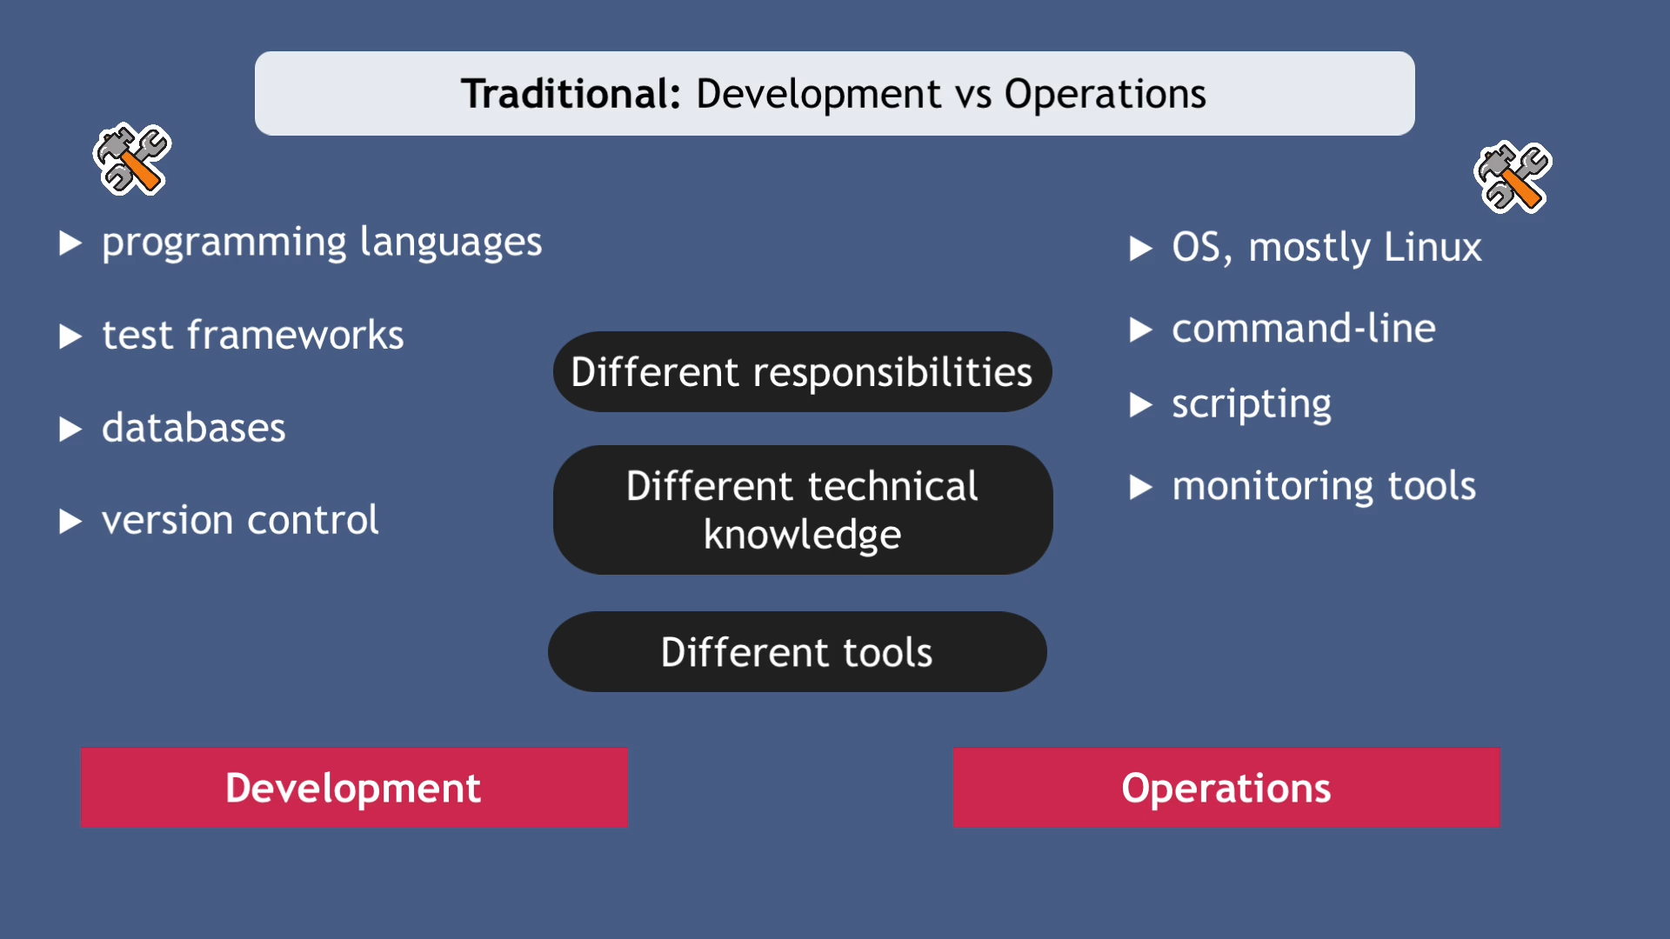

Slide 9
Traditional: Problems faced
DEVELOPMENT:
Documents instructions on how to deploy
Change request & release window.
OPERATIONS:
Require configuration, env variables, some folders on server.
Executes the instructions. (not clear, missing steps, etc)
No proper communication between Dev & Ops Teams
No interface between two teams.
Solution: DevOps Culture

Slide 10
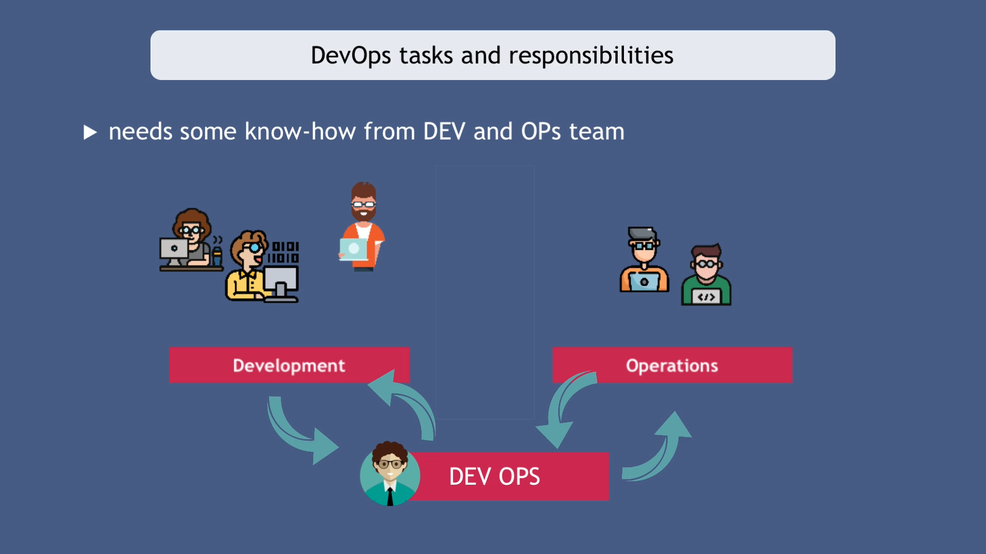
Evolution of DevOps
It was just a culture when it started, way of working between DEV’s and OP’s
Common language of communication.
Became its own job and role.
Many new tools and concepts were developed to help DevOps bridge the gap and automate the software development process.

Slide 11
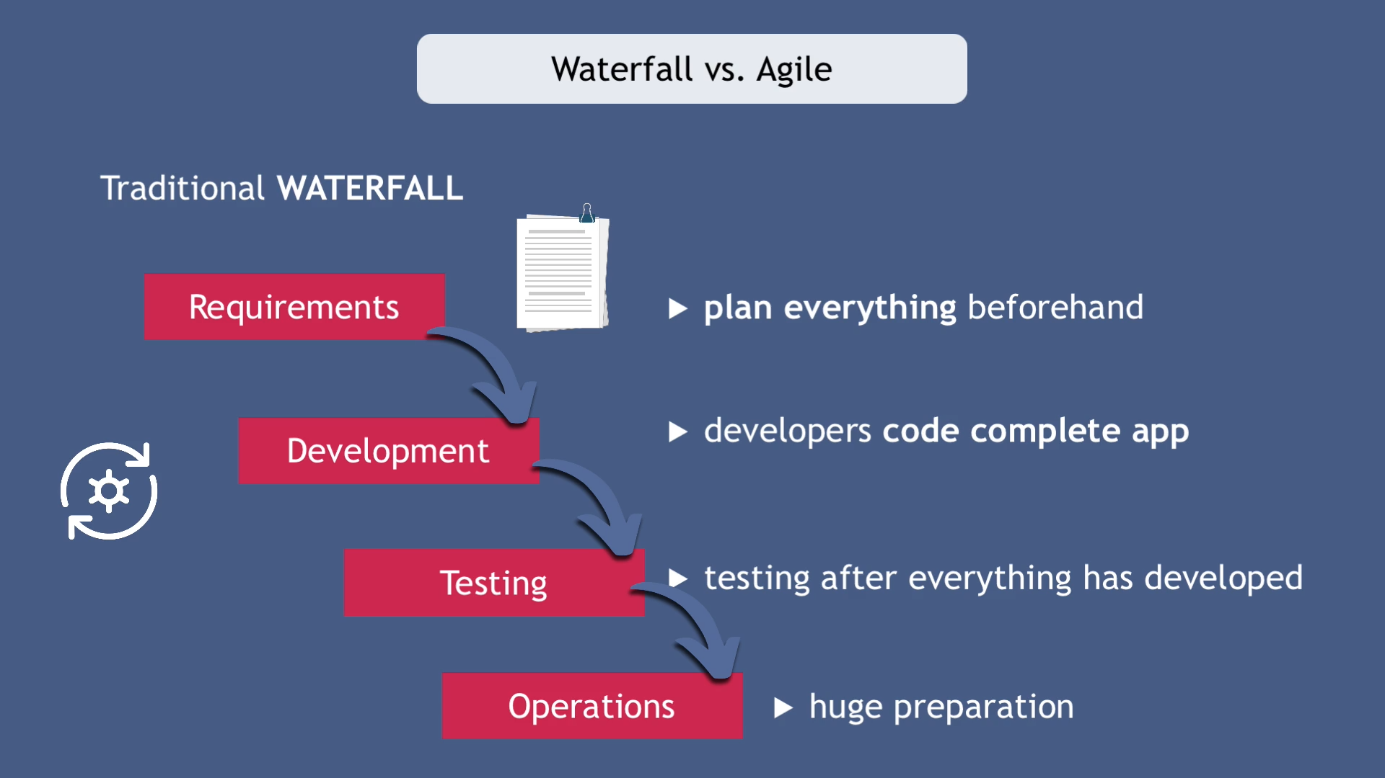

Slide 12
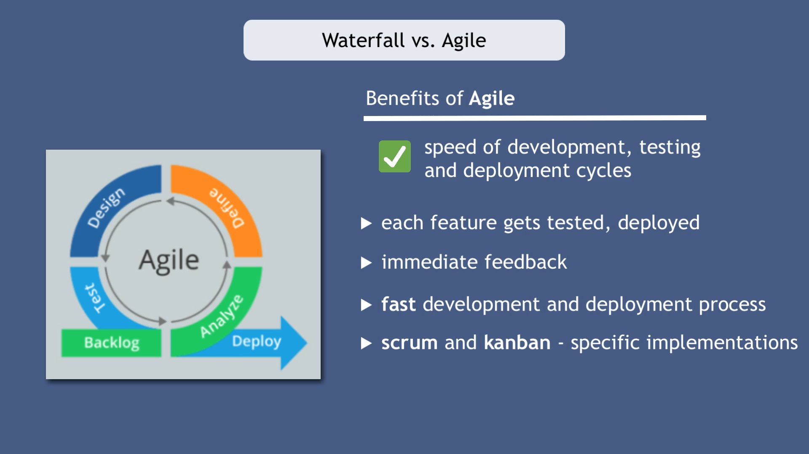
Continuous Integration
Continuous Delivery

Slide 13
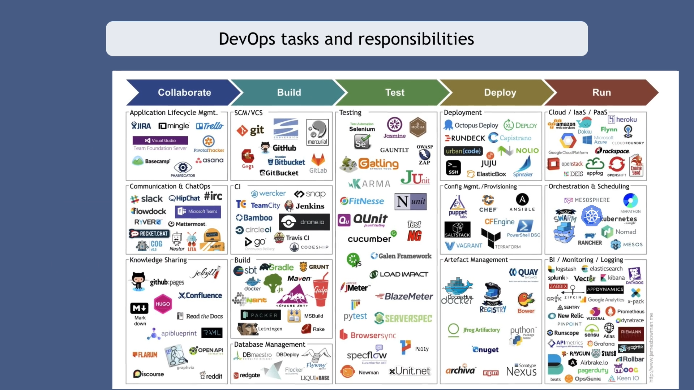
DevOps Tasks & Responsibilities

Slide 14
Cloud Computing Overview

Slide 15
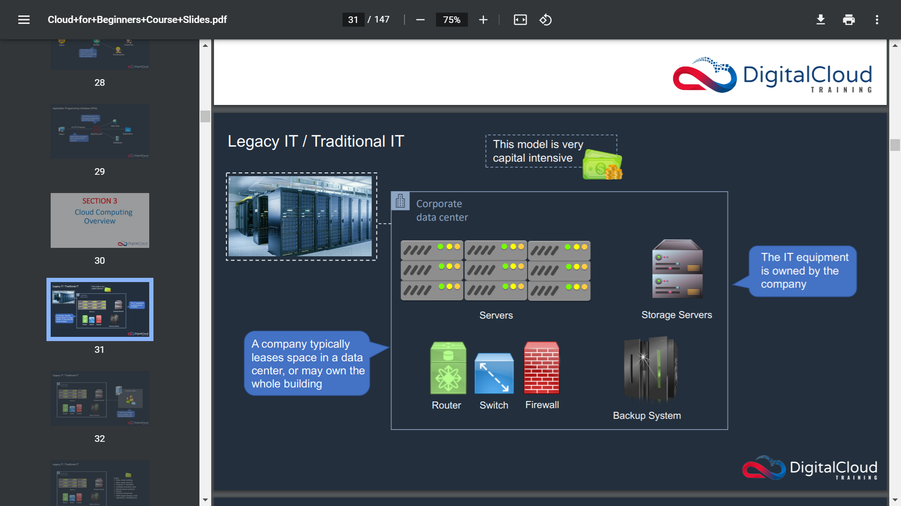

Slide 16
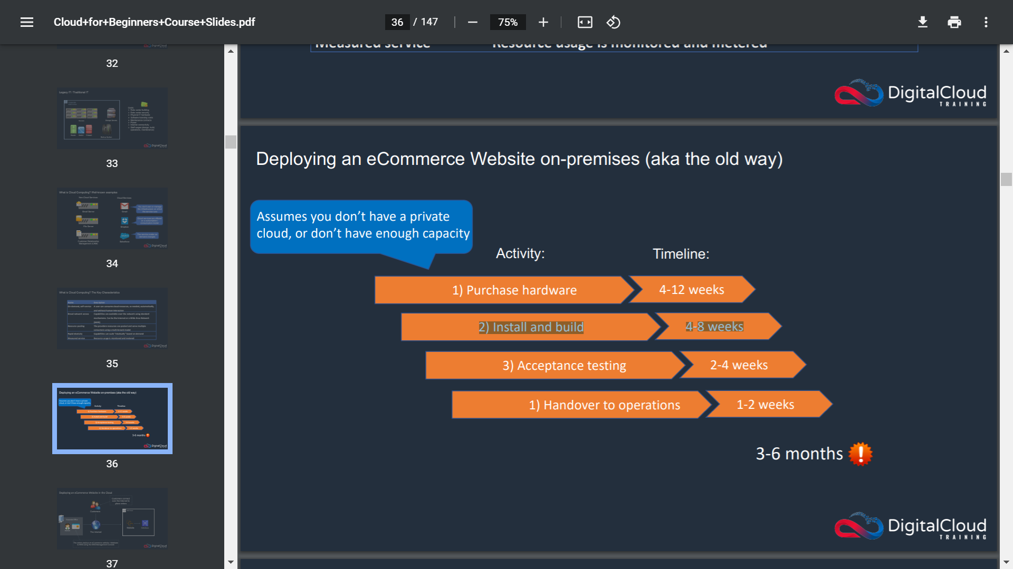

Slide 17
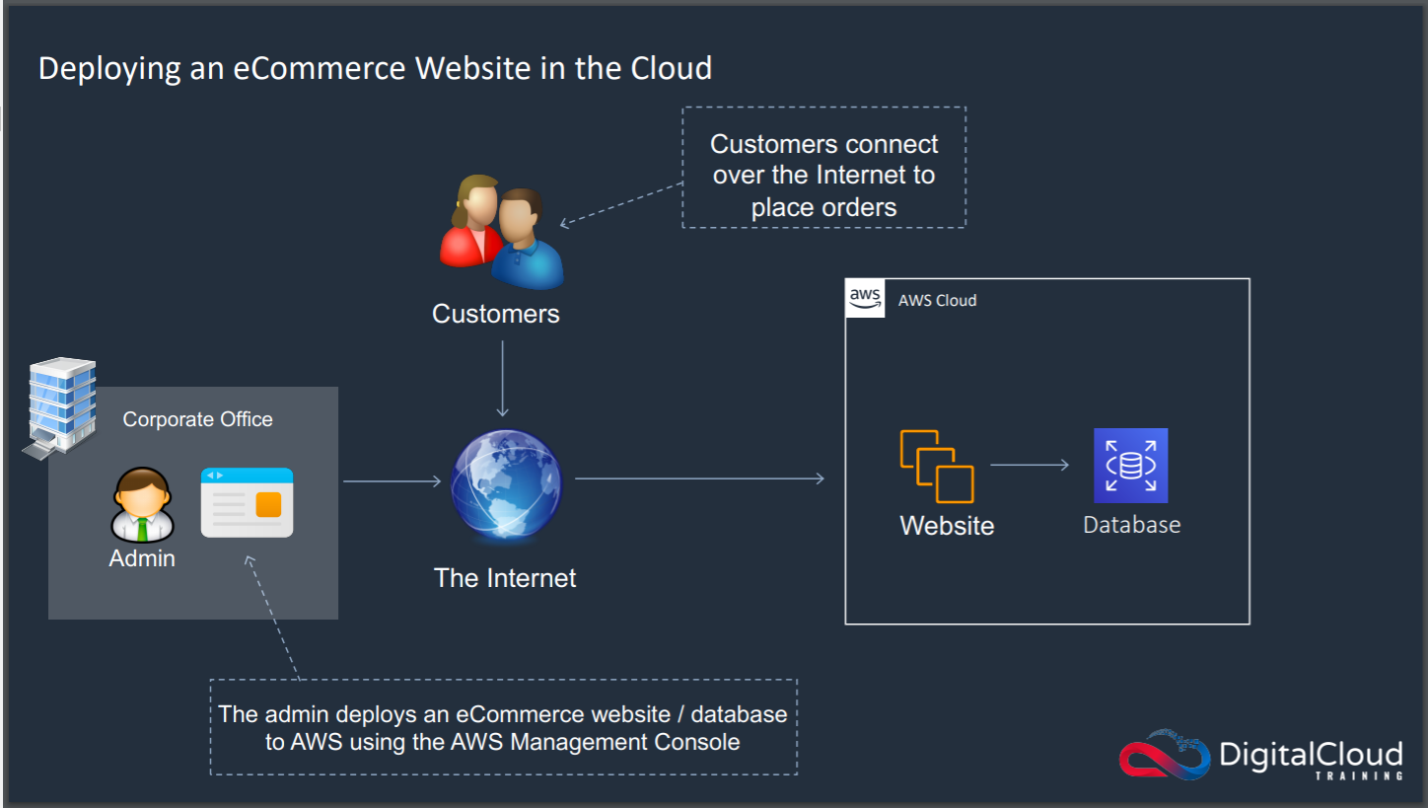

Slide 18
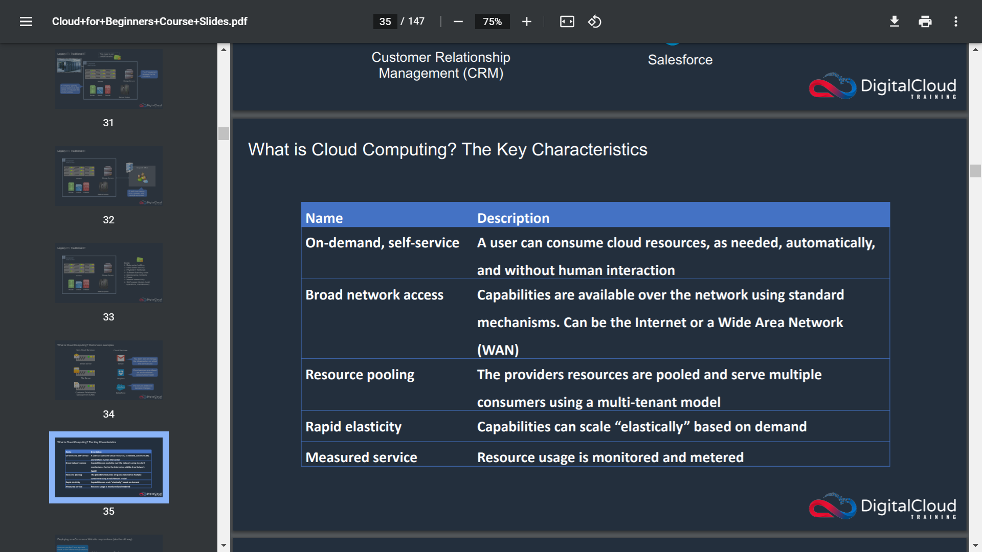

Slide 19
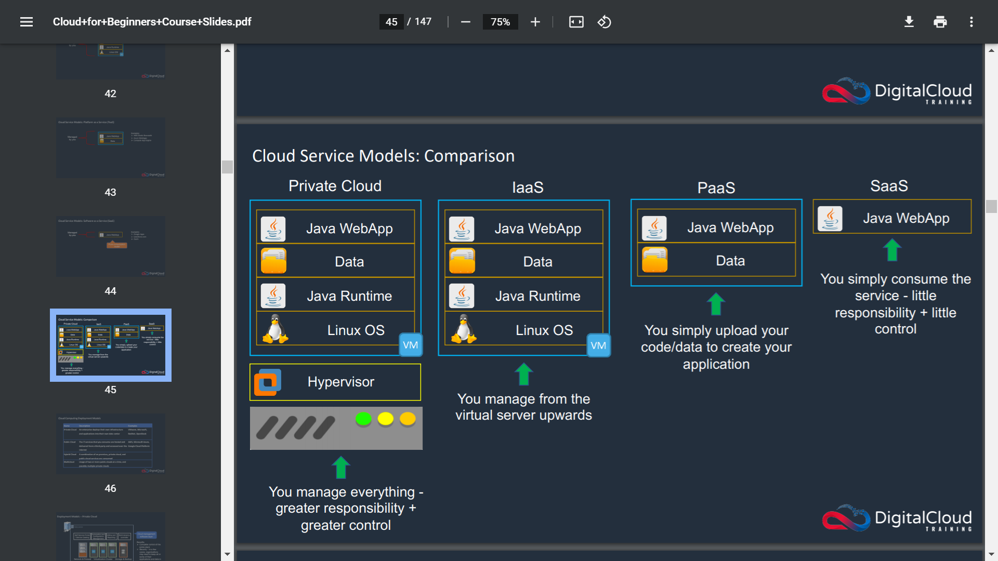

Slide 20
Thank You…!!

